Slide 1
Introduction to JavaScript
Presented by
Iyappan S (403926)
Web developer, DEp

Slide 2
Scripting overview
Enhances functionality and appearance
Client-side scripting
Makes pages more dynamic and interactive
Foundation for complex server-side scripting
Program development
Program control

Slide 3
Intro to JS / Basic
JavaScript is the programming language of HTML and the Web.
Browsers have limited functionality
Text, images, tables, frames
JavaScript allows for interactivity
Browser/page manipulation
Reacting to user actions

Slide 4
Intro to JS / Basic
A type of programming language
Easy to learn
Developed by Netscape
Now a standard exists – ES6 is the latest JS Standard www.ecma-international.org/publications/ standards/ECMA-262.HTM
Example -Program 01.

Slide 5
Intro to JS / Basic
Commenting in js
// - Used for Commenting single line of Code.
/* */ - Used for Commenting multiple line of Code.
Including js file into HTML :
Inline
Script tag
External file
Example -Program 08.

Slide 6
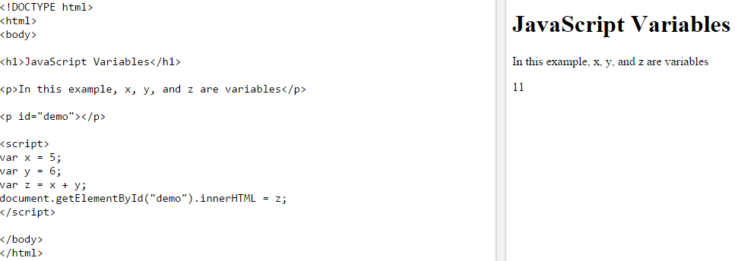
Variables
Variables
JavaScript variables are containers for storing data values.

Slide 7
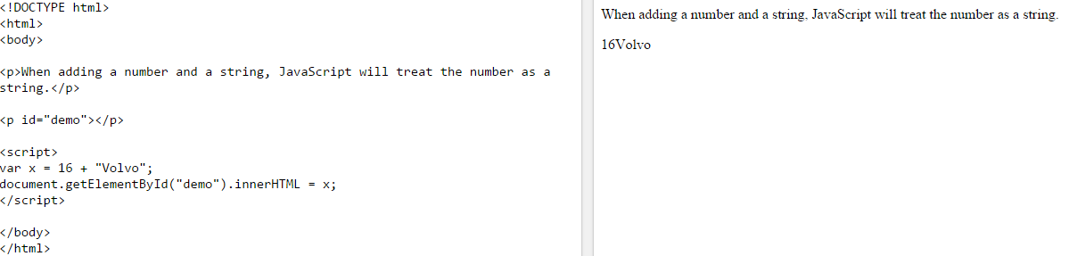
Data types
JavaScript Data Types
JavaScript variables can hold many data types: numbers, strings, arrays, objects and more:
var length = 16; // Number var lastName = "Johnson"; // String var cars = ["Saab", "Volvo", "BMW"]; // Array var x = {firstName:"John", lastName:"Doe"}; // Object

Slide 8
Data types
Var Keyword – States the scope of the variable.
var a = “Krish” - Functioned scope variable
b = “Ram” – Global scope
It is always advisable to use the “var” keyword.
Traditional many feels and believes that “var” keyword should be used.
Very helpful while creating many functions honoring the scope of variables.

Slide 9
Data types
Use camelCase for variable names.
Start a variable with _ or $ sign, but not as “$ some value”
Eg :
var _a;
var $b;
Var $ some text;
Use semicolon at the end of statement.
Example 02 program.

Slide 10
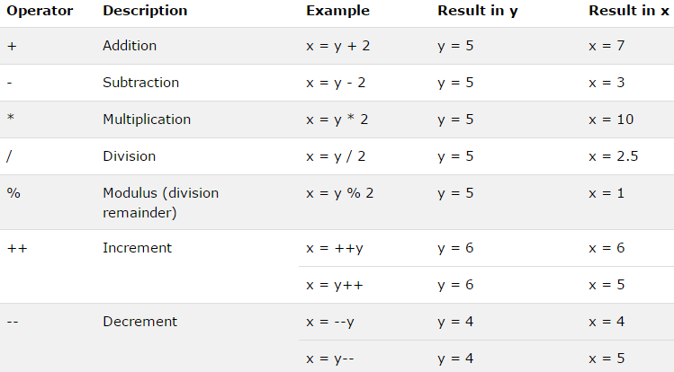
Operators
JavaScript operators are used to assign values, compare values, perform arithmetic operations, and more.
JavaScript Arithmetic Operators- Arithmetic operators are used to perform arithmetic between variables and/or values.

Slide 11
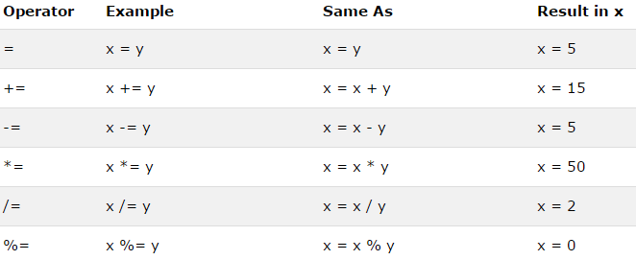
Operators
JavaScript Assignment Operators
Assignment operators are used to assign values to JavaScript variables.

Slide 12
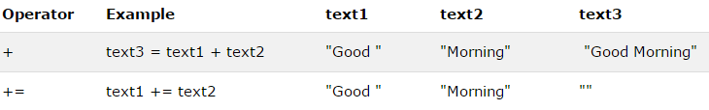
Operators
JavaScript String Operators
The + operator, and the += operator can also be used to concatenate (add) strings.

Slide 13
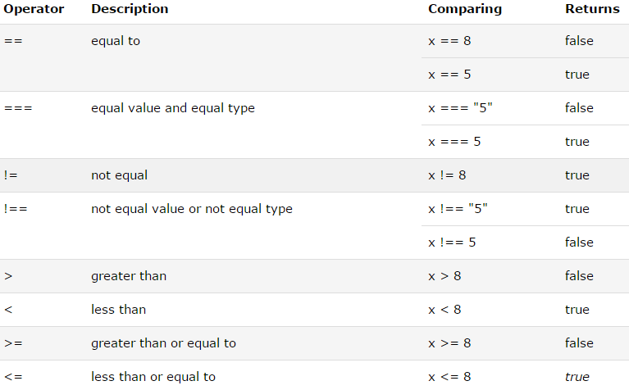
Operators
Comparison Operators
Comparison operators are used in logical statements to determine equality or difference between variables or values.
Given that x = 5, the table below explains the comparison operators:

Slide 14
Operators
Truthy and Falsey Values :
Falsey :
False ( Boolean Value )
myResult = false ? "Truthy value" : "falsey values";
Zero :
myResult = 0 ? "Truthy value" : "falsey values";
Undefined
a = false ? "truthy" : "falsey"
NaN :
myResult = typeof 24 / “Bob”;
myResult = false ? “Trythy” : “Falsey”
Truthy :
All other values are Truthy values.

Slide 15
Operators
Conditional (Ternary) Operator
The conditional operator assigns a value to a variable based on a condition.

Slide 16
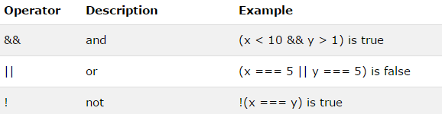
Operators
Logical Operators
Logical operators are used to determine the logic between variables or values.

Slide 17
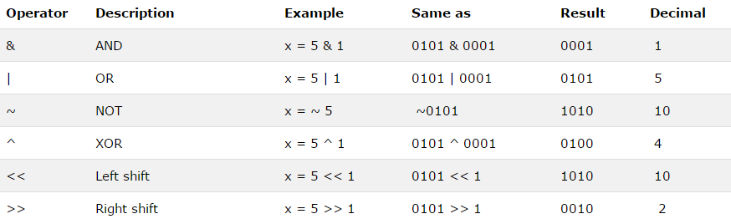
Operators
JavaScript Bitwise Operators
Bit operators work on 32 bits numbers. Any numeric operand in the operation is converted into a 32 bit number. The result is converted back to a JavaScript number.

Slide 18
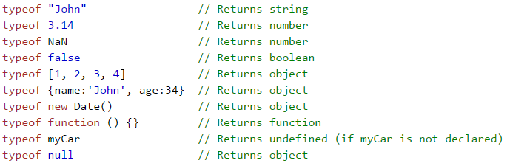
Operators
The typeof Operator
The typeof operator returns the type of a variable, object, function or expression:

Slide 19
Operators
The delete Operator
The delete operator deletes a property from an object:

Slide 20
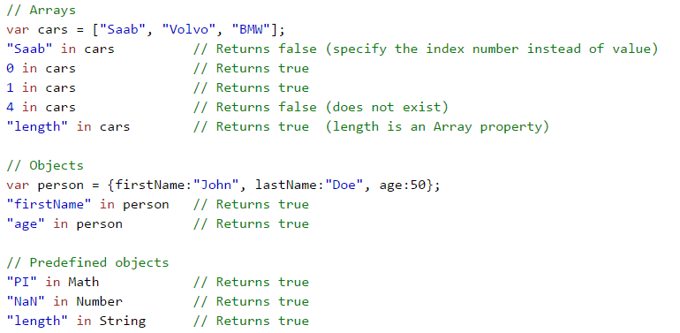
Operators
The in Operator
The in operator returns true if the specified property is in the specified object, otherwise false:

Slide 21
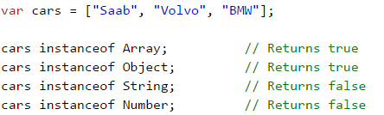
Operators
The instanceof Operator
The instanceof operator returns true if the specified object is an instance of the specified object:

Slide 22
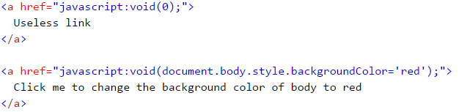
Operators
The void Operator
The void operator evaluates an expression and returns undefined. This operator is often used to obtain the undefined primitive value, using "void(0)" (useful when evaluating an expression without using the return value).

Slide 23
Conditionals and Loops
The if Statement
if (condition) { block of code to be executed if the condition is true }
The else Statement
if (condition) { block of code to be executed if the condition is true } else { block of code to be executed if the condition is false }

Slide 24
Conditionals and Loops
The else if Statement
if (condition1) { block of code to be executed if condition1 is true } else if (condition2) { block of code to be executed if the condition1 is false and condition2 is true } else { block of code to be executed if the condition1 is false and condition2 is false }

Slide 25
Conditionals and Loops
<html>
<body>
<p id="demo">Display the result here.</p>
<script>
var greeting;
var hour = new Date().getHours();
if (hour < 18) {
greeting = "Good day";
} else {
greeting = "Good evening";
}
document.getElementById("demo").innerHTML = greeting;
</script>
</body>
</html>

Slide 26
D0-While Loops :
Syntax :
do{
block of code;
} while(condition);
The block of code is executed once and then the condition is evaluated.

Slide 27
While Loops
While loop : syntax :
while(condition){
Block of code;
}
Difference Between while and do-while loop is that do-while loop executes atleast once before checking on the condition but while loop executes only when the block of statements are true.

Slide 28
For and for…in Loops
For ( variable initialization ; condition ; increment/decrement opertator){
Block of code ;
}
For ( variable in argument){
block of code;
}
The difference between For loop and For…In loop is that the condition in for loop can be changed/manipulated but not in For…in

Slide 29

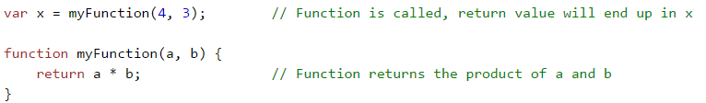
JavaScript Functions
A JavaScript function is a block of code designed to perform a particular task.

Slide 30

Why Functions?
You can reuse code: Define the code once, and use it many times.
You can use the same code many times with different arguments, to produce different results.

Slide 31
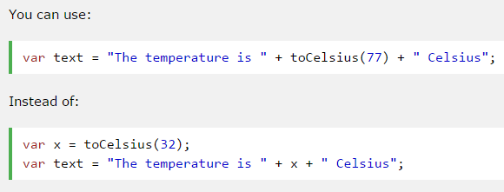
Functions Used as Variables
You can reuse code: Define the code once, and use it many times.
You can use the same code many times with different arguments, to produce different results.

Slide 32
Functions Used as Variables
The syntax for a function literal is much like a function statement, except that it is used as an expression rather than a statement and no function name is required.
<script type="text/javascript">
var variablename = function(Argument List){ Function Body };
</script>
Syntactically, you can specify a function name while creating a literal function as follows.
But this name does not have any significance, so it is not worthwhile.

Slide 33
Events
HTML events are "things" that happen to HTML elements.
When JavaScript is used in HTML pages, JavaScript can "react" on these events.
Eg : Program 1.

Slide 34
Events
Few of HTML Events are as follows :
onchange
onclick
onmouseover
onmouseout
onkeydown
onload etc

Slide 35
Events
Few of HTML Events are classified as follows :
Mouse event - eg: onmouseover
Keyboard event - eg : onkeyup
Frame event - eg : onscroll
Form Event - eg: onsubmit
Drag Event – eg : ondragover
Touch Events – eg : ontouchstart
http://www.w3schools.com/jsref/dom_obj_event.asp

Slide 36
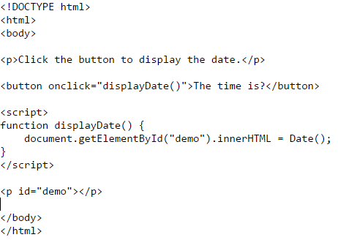
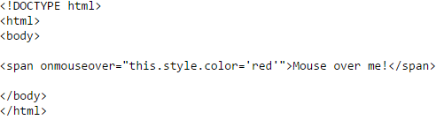
Events

Slide 37
Scopes of variables :
Local scope :
Eg : Var a = 5; (Inside a function);
Global scope :
Eg : alphabet = 6; (Defining the variable globally).
Never use the Global variables unless it is absolutely necessary.
Example program : 7.Global and functional Scope

Slide 38
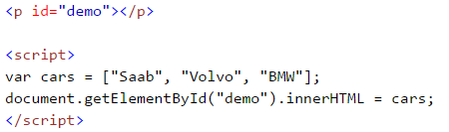
Arrays and Objects
JavaScript Arrays
JavaScript arrays are used to store multiple values in a single variable.
Refer to the program “Javascript_arrays.html”.
Associative arrays be of restricted use and must be avoided.

Slide 39
Arrays and Objects
JavaScript Arrays
Pushing a value to an array using “.push()” method
Deleting the last element of an array using “.pop()” method.
Removing first element of an array using “.shift()” method.
Adding element to the first position using “.unshift()” method.
Removing an element using its index – “.slice(pos, 1)”;
There are quite a lot of methods to manipulate array and please go through all those.

Slide 40
Arrays and Objects
JavaScript objects are containers for named values.
Objects are collection of properties and methods.
Properties :
The name:values pairs (in JavaScript objects) are called properties.
Methods :
Methods are actions that can be performed on objects.
Methods are stored in properties as function definitions.
Unlike array which is referred using indices, Objects are referred using the key value pair.
The values are written as name:value pairs (name and value separated by a colon).
Refer Object Literals program.

Slide 41
JavaScript Form Validation
Refer program “form-validation.html”
Refer program “form-retype-password.html”
Checking whether the text entered is a number using NaN method. Refer to the “number-val.html”.
URL : http://www.javatpoint.com/javascript-form-validation

Slide 42
Regular Expressions
abc… Letters
123… Digits
\d Any Digit
\D Any Non-digit character
. Any Character
\. Period
[abc] Only a, b, or c
[^abc] Not a, b, nor c
[a-z] Characters a to z
[0-9] Numbers 0 to 9

Slide 43
Regular Expressions
\w Any Alphanumeric character
\W Any Non-alphanumeric character
{m} m Repetitions
{m,n} m to n Repetitions
* Zero or more repetitions
+ One or more repetitions
? Optional character
\s Any Whitespace
\S Any Non-whitespace character
^…$ Starts and ends

Slide 44
Regular Expressions
(…) Capture Group
(a(bc)) Capture Sub-group
(.*) Capture all
(abc|def) Matches abc or def
https://msdn.microsoft.com/en-us/library/ae5bf541(v=vs.90).aspx

Slide 45
Built in JS objects

Slide 46
The HTML Document Object Model

Slide 47
Window Object & Document

Slide 48
Navigator, History, and Location, History, Screen Objects, cookies

Slide 49
Dynamic forms

Slide 50
Dynamic html

